Slide 1



AtliQ mart campaign analysis
Presented by
Madhu Vanthi Krishnamoorthy

Slide 2

AtliQ mart campaign analysis
AtliQ Mart is a retail giant with over 50 supermarkets in the southern region of India. All their 50 stores ran a massive promotion during the Diwali 2023 and Sankranti 2024 (festive time in India) on their AtliQ branded products.
AtliQ mart

Slide 3

The sales director is seeking insights into the performance of various promotions to inform future decisions. Additionally, they require an overview of store performance, including the highest number of stores across cities and the top-performing stores. Furthermore, they are interested in understanding product performance in relation to different promotional types, specifically in comparison with the percentage of incremental revenue and the quantity of products sold.
Problem statement
The sales director wants to understand which promotions did well and which did not so that they can make informed decisions for their next promotional period. Also, the overview of stores ,highest number of stores across cities and the top performers. With respect to products and their performance in terms of different Promo types in comparison with percentage of Incremental revenue and sold quantity.

Slide 4
Data sets
dim_campaigns –Comprehensive information about the campaigns.
dim_products –Information regarding products.
dim_stores- Details about stores and their respected locations.
fact_events-Complete dataset of sales and revenue during the campaign season.

Slide 5
AtliQ mart campaign analysis
The analysis of stores, focusing on the top-performing stores in terms of revenue, sales, IR%,ISU%. This analysis will provide valuable insights into the best-performing stores, enabling informed decision-making and strategic planning for the future.
This analysis helps businesses determine evaluate the effectiveness of promotional campaigns, and identify opportunities for revenue growth.
AtliQ mart
This analysis will provide valuable insights into customer segmentation across various promotion’s, shedding light on the effectiveness of these promotions and the opportunities

Slide 6
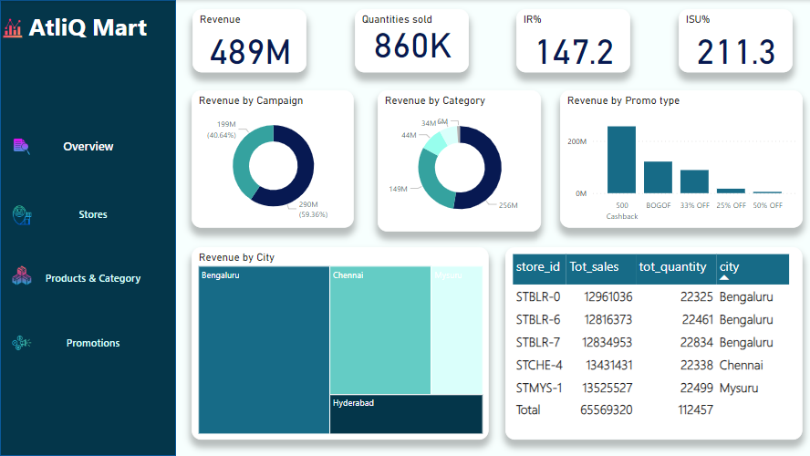
Dashboard

Slide 7
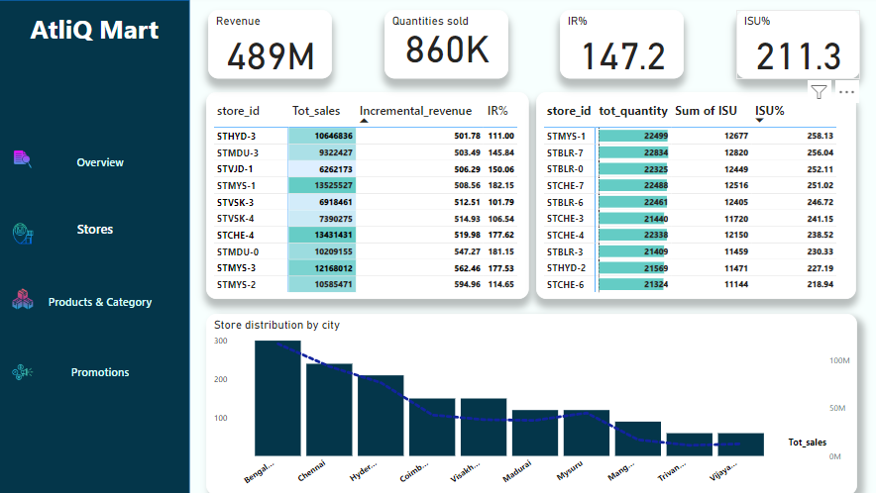
Store sales summary
Store ID STMYS-1 has achieved the highest sales and incremental revenue percentage (IR%), indicating a strong performance. Additionally, STMYS-2 has shown a significant increase in incremental revenue. Furthermore, store STBLR-1 has emerged as the top performer in terms of quantity sold.
It's important to note that the IR% represents the incremental revenue to the change in quantities sold, while the ISU% indicates the difference in quantities sold before and after promotions, such as BOGOF, 33% off, and 25% off.
These insights will provide a comprehensive understanding of the stores' performance, enabling informed decision-making and strategic planning for the future.

Slide 8
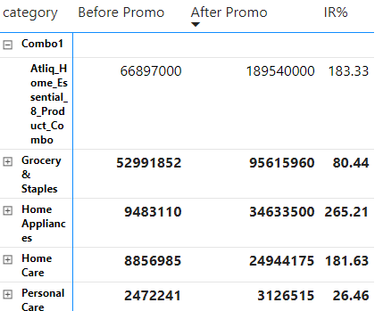
Product summary
The Combo1 category has experienced a significant increase in total revenue during the campaign season.
In contrast, the home appliances category has shown a remarkable 265% increase in incremental revenue percentage (IR%) compared to its sales before the promotion.
This data provides valuable insights into the performance of these categories during the promotional period, enabling informed decision-making and strategic planning for the future.

Slide 9
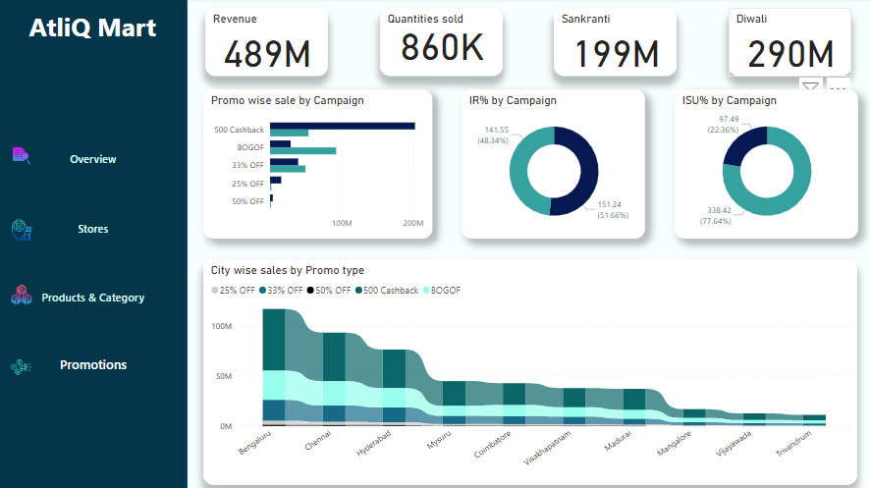
Product summary
The revenue generated during the Diwali season significantly surpasses that of the Sankranti season. Additionally, the "prom type 500 cashback" outperformed the "BOGOF" promotion, ranking second in sales in terms of IR%.
The "25% off" followed by "50% off" promotion types are the lowest performers in terms of ISU%. On the other hand, "BOGOF" ranks highest in both IR% and ISU% among the different promotion types.
The Diwali season is known for its substantial impact on sales and revenue, making it a crucial period for businesses to implement effective marketing strategies and promotions.

Slide 10
Thank you

